Slide 1
Lecture 12: Chemical Bonding –Diatomic Molecules
_{Contd.}

Slide 2
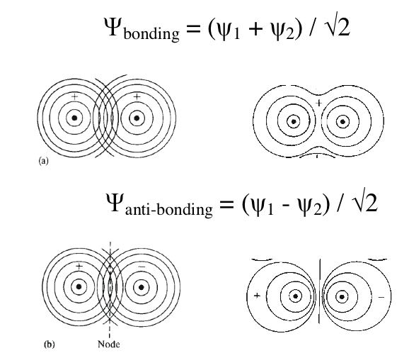
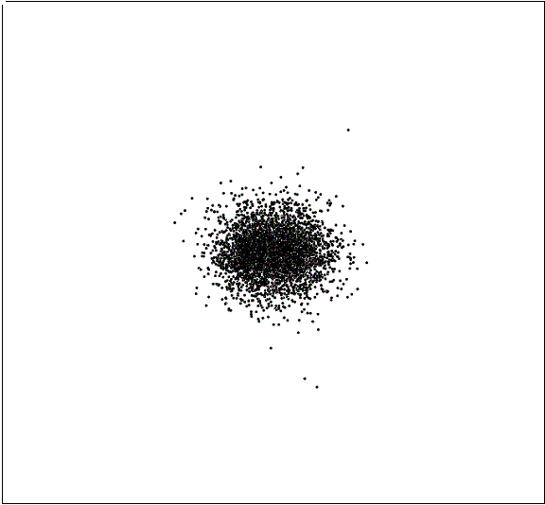
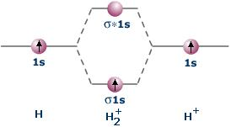
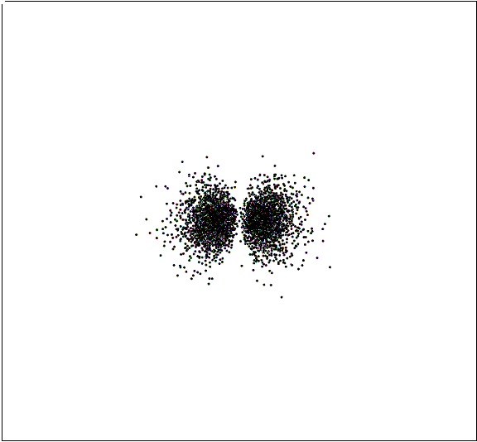
Molecular Orbital Theory- H2⁺

Slide 3
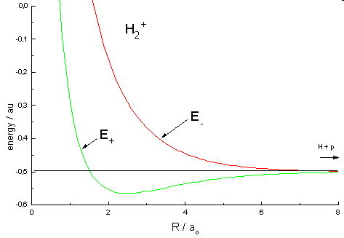
Bonding/Antibonding energy is f(R_{AB})
H₂⁺
S = f(R_{AB})
H_{ii} = H_{ii}(R_{AB})
H_{ij} = H_{ij}(R_{AB})
Energy = E(R_{AB})
Calculate energies as a function
Of internuclear separation, R_{AB}:
A bound state and an unbound state
Textbook pictures: Represents
energies of bonding and anti-bonding
levels at equilibrium R_{AB}

Slide 4
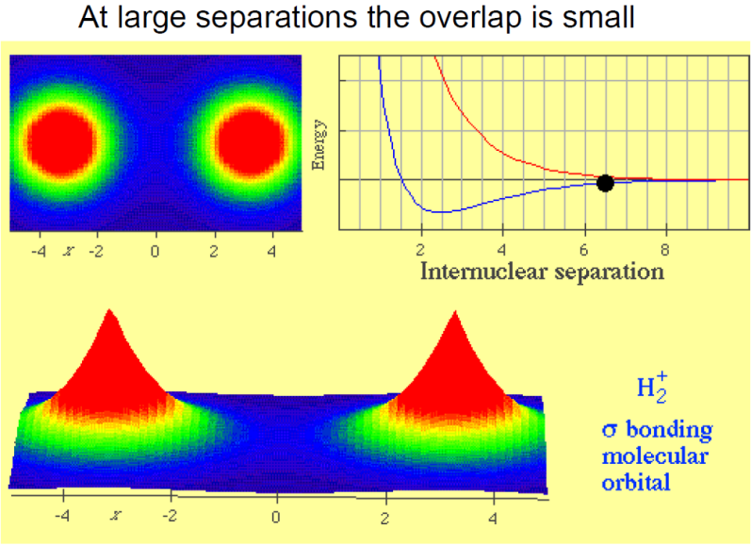
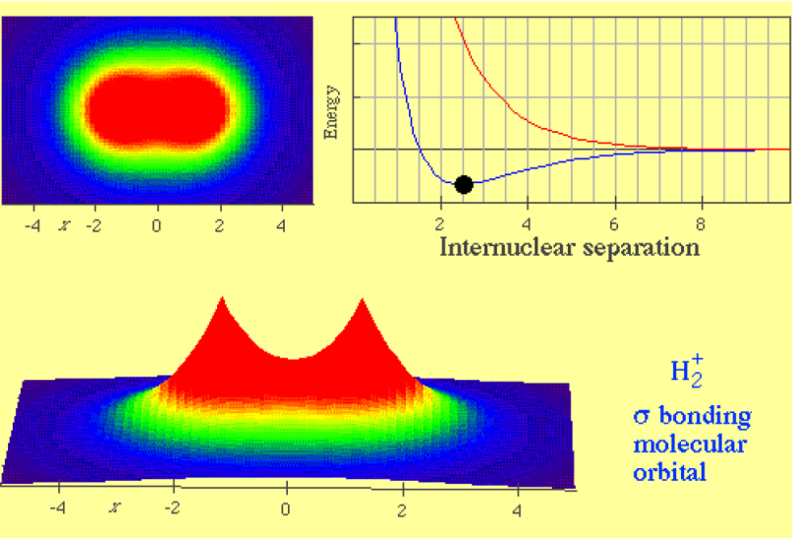
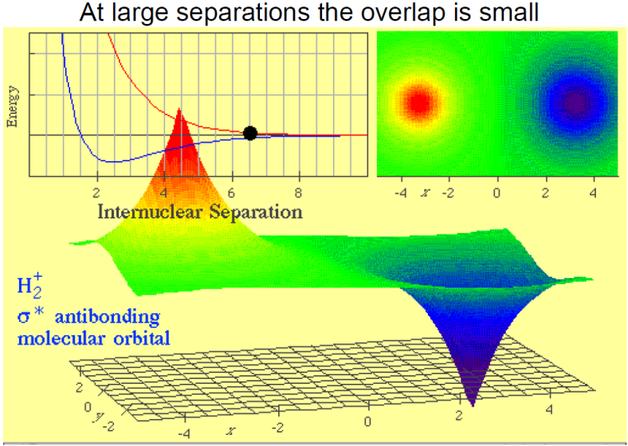
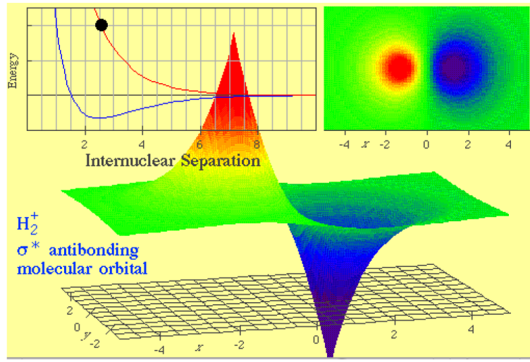
Electron Densities and Energy: f(R_{AB})

Slide 5
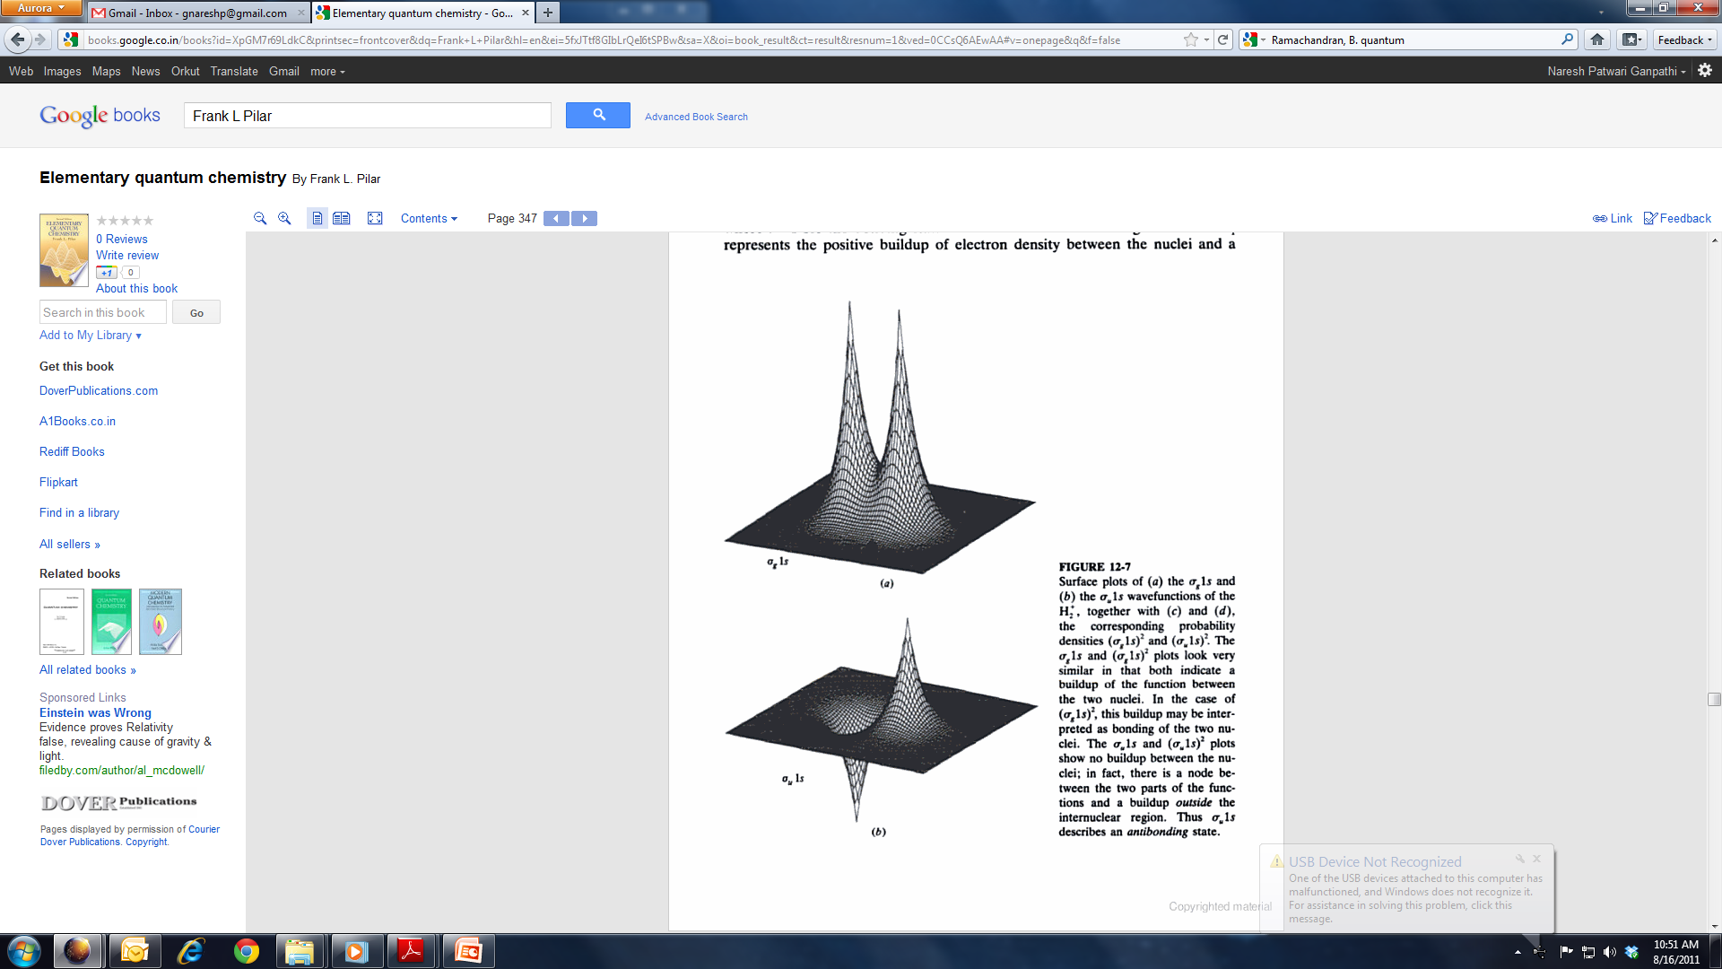
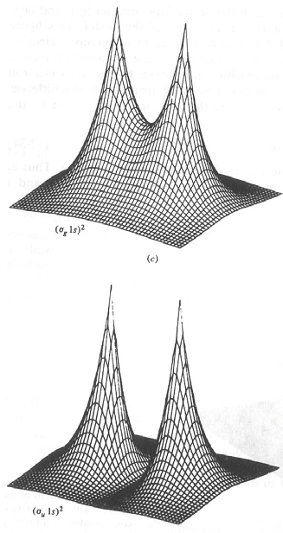
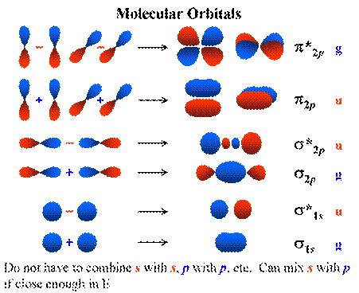
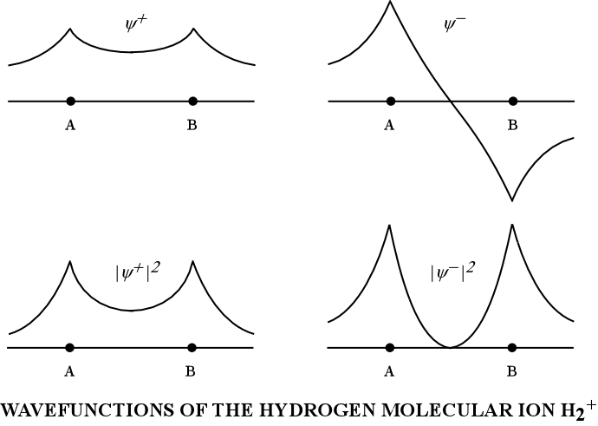
Sigma Bonding with 1s Orbitals

Slide 6
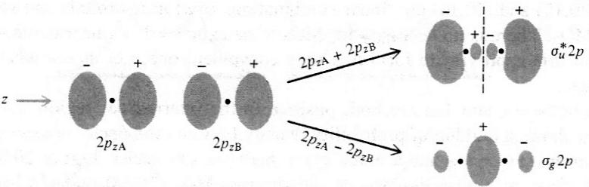
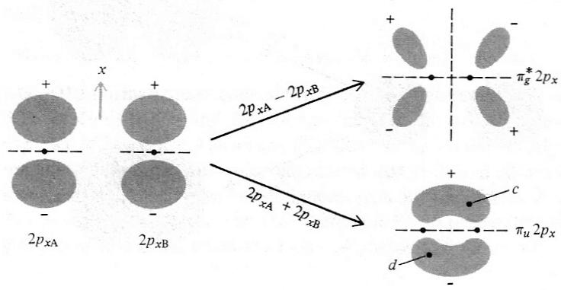
LCAO of p-orbitals: σ- and π- bonds
Note the signs, symmetries and nodes

Slide 7

Molecular Electronic Structure: Bonding
Chemical Bond Formation:
Heart of Chemistry

Slide 8
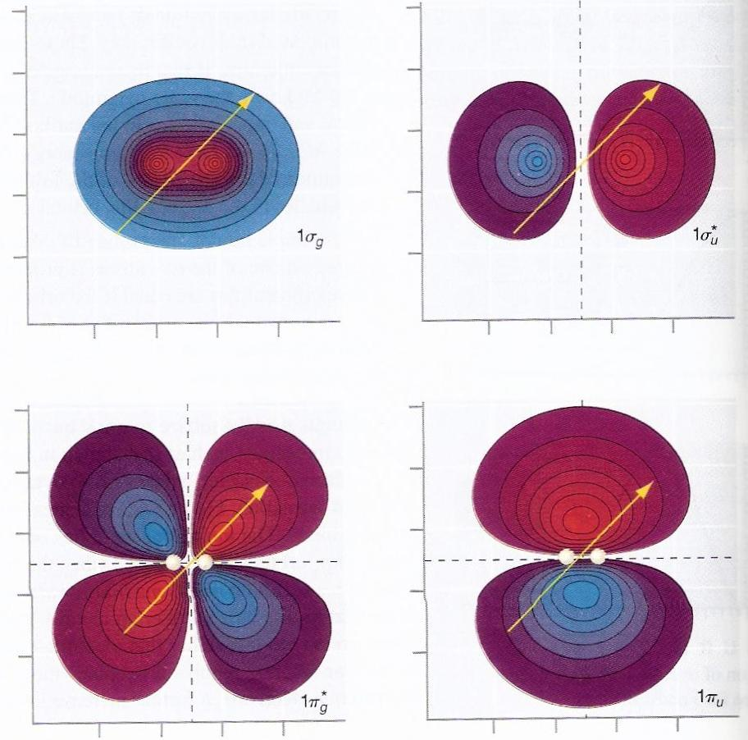
Symmetry and Nomenclature of MOs
Gerade (g) (symmetric) and Ungerade (u) (antisymmetric)
wrt inversion of coordinates (operation)!
Hydrogen molecule ion:
“b”→ Bonding using σ:
symmetric→s_{g}
“a”→ antibonding using σ:
antisymmetric→ s_{u}*

Slide 9
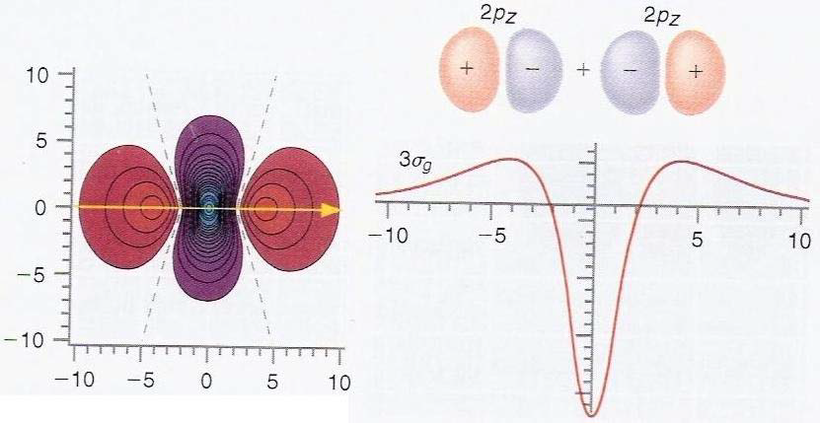
Sigma Bonding with 2p Orbitals

Slide 10
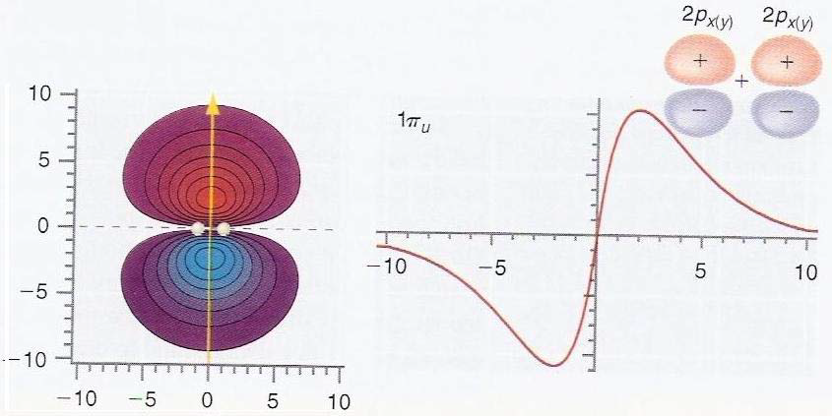
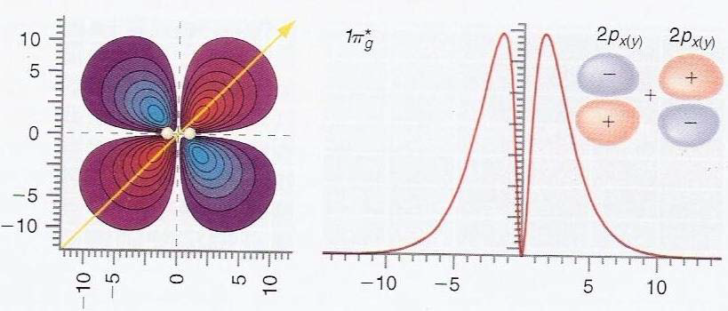
Pi Bonding with 2p Orbitals
Note the signs, symmetries and nodes

Slide 11
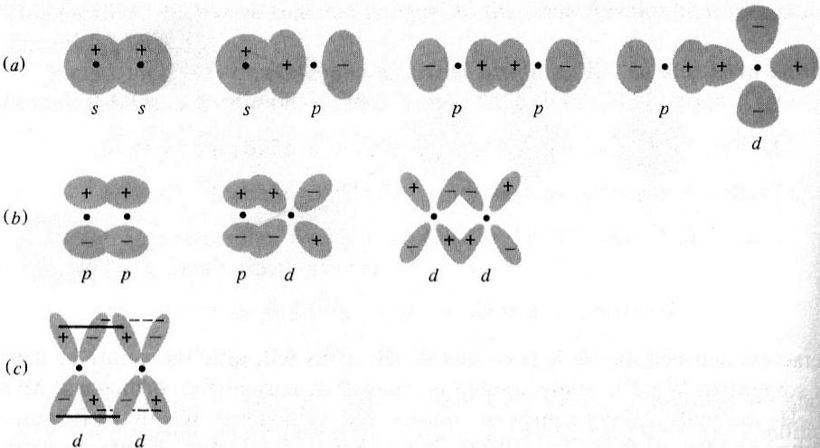
Types of Bonds

Slide 12
-
e⁻
Bonding: H₂ molecule
r_{1A}
r_{1B}
Born – Oppenheimer Approximation
r₁
H_{A}
+
+
H_{B}
r₂
R
r_{2A}
r_{2B}
e⁻
-
NOT a constant
CANNOT be Solved
For all the molecules except the simplest molecule H₂⁺ the Schrodinger equation cannot be solved.
We need methods to find approximate solutions

Slide 13
Molecular Orbital Theory of H₂
For H₂⁺
Place the second electron in the bonding orbital to get H₂ (ground state)

Slide 14
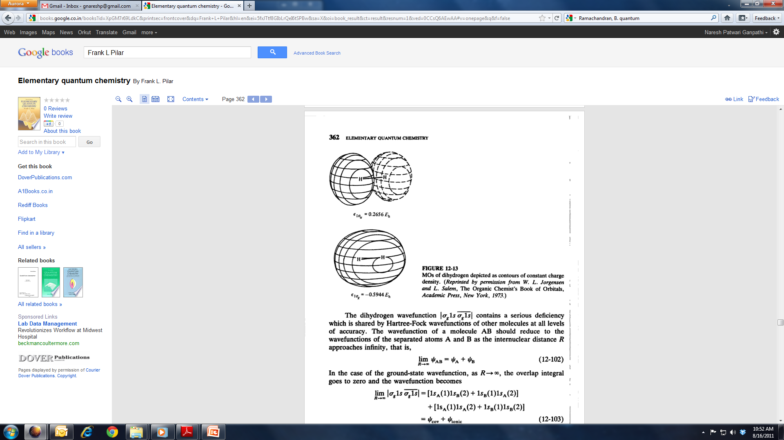
Molecular Orbital Theory of H₂
Spatial Part
Ionic terms: overemphasized

Slide 15
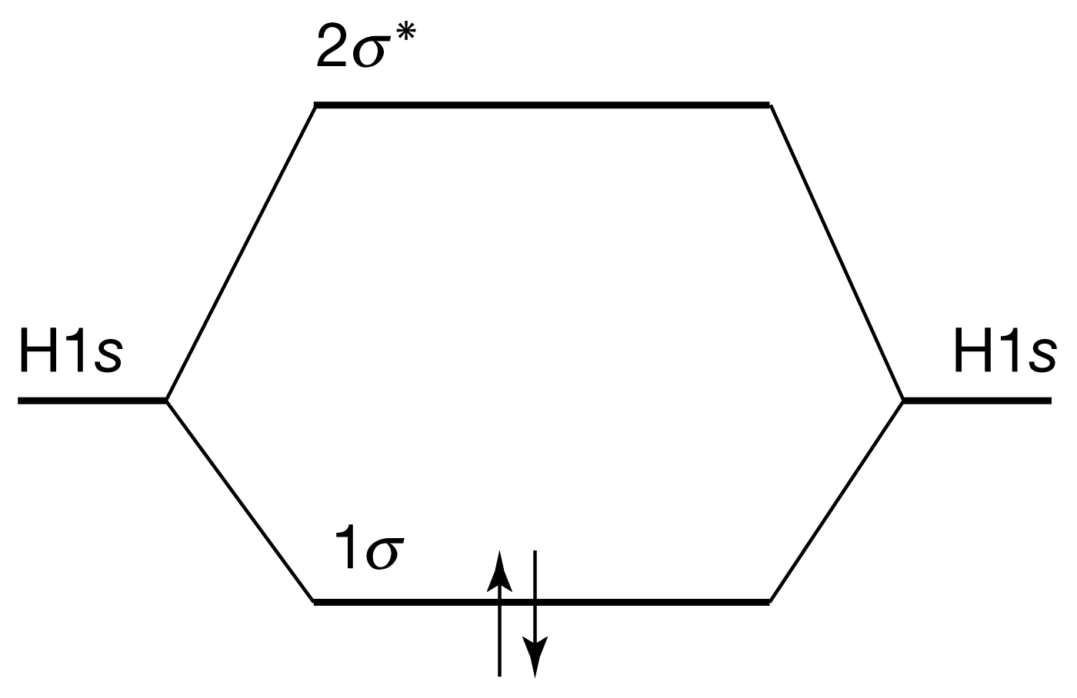
Molecular Orbital Theory of H₂

Slide 16
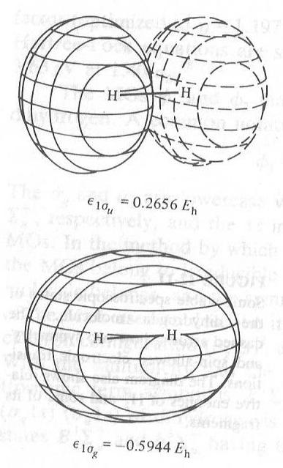
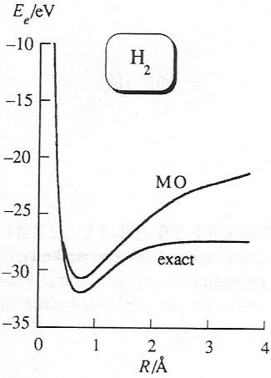
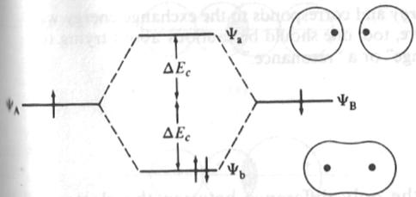
Dihydrogen Molecule: One more electron goes to bonding orbital
*
Increased stabilization: Stronger bond!
Effective nuclear charge changes the absolute
Energy levels and the orbitals!
Matching of AO energies needed for LCAO-MO
If energies are not close to each other, AOs would not interact to form MOs.

Slide 17
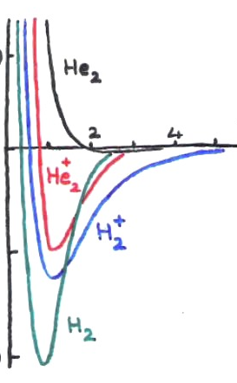
Diatoms of First Row: H₂⁺, H₂ ,He₂, He₂⁺
He₂
He₂⁺
H₂⁺
H₂
Species | No. of electrons | Electron confign. | Bond order | Bond length (pm) | Binding energy (kJ mol⁻¹
H₂⁺ | 1 | (1σ)¹ | 0.5 | 106 | 268
H₂ | 2 | (1σ)² | 1 | 74 | 457
He₂⁺ | 3 | (1σ)²(1σ∗)¹ | 0.5 | 108 | 241
He₂ | 4 | (1σ)²(1σ∗)² | 0 | -- | ---
Notes:
Here interesting to note what MPT predicts for He2+ existence, and non existense of He2 itself. No E minima for B MO therefore no bond formation can ever happen.

Slide 18
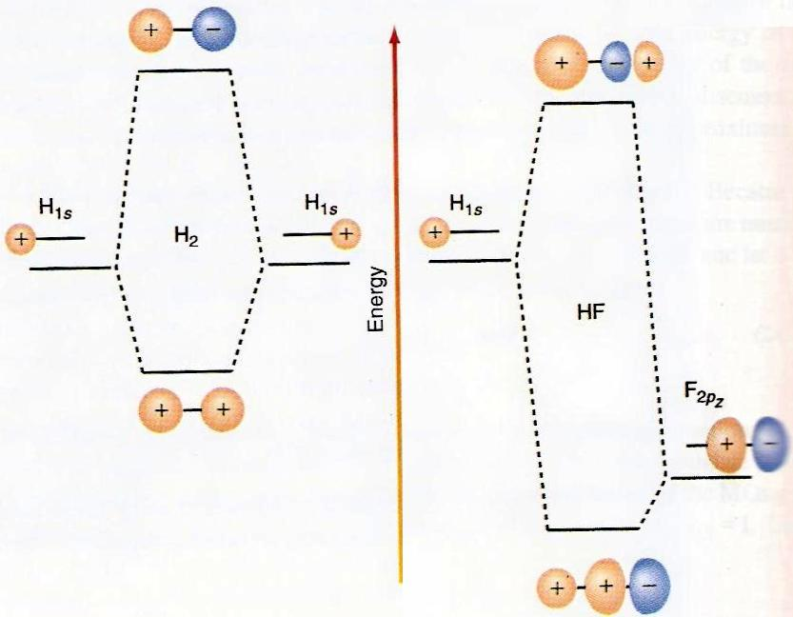
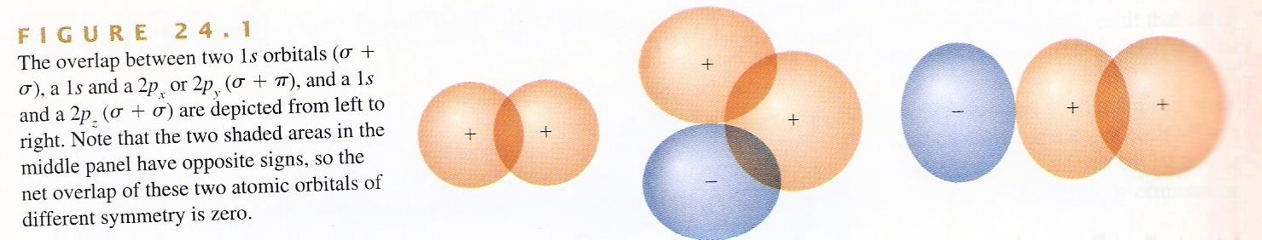
Matching of AO energies/symmetries
Z-axis
S=0
P_{X/Y} +s
P_{Z} + s
Both symmetry and energy
matching is required for MO
Valence electrons are most important for bonding
S>0
Due to large difference in energy of 1s(H) and 1s(F),
LCAO-MO for both 1S is not feasible in HF.
Rather only 2Pz(F) [NOT 2Px/y(F)] and 1S(H) form a σ-bond.

Slide 19
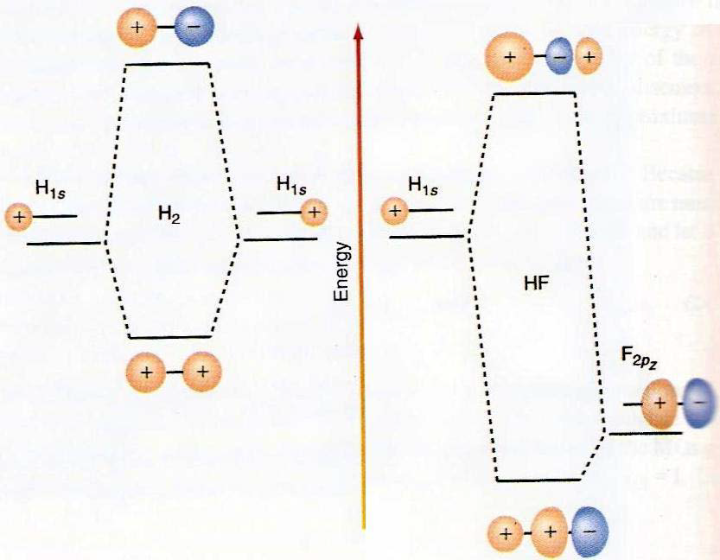
Matching of AO energies for MO
Both symmetry and energy
Matching is required for MO.
Valence electrons are most important
Due to large difference in energy of 1s(H) and 1s(F), LCAO-MO for both 1s is not feasible in HF.
Rather, 2p_{z}(F) and 1s(H) form a sigma bond.

Slide 20
Bonding in 2nd Row Homo-Diatomic Molecules
2p
2p
2s
2s
1s
1s
The orbital energies of the two approaching atoms are identical before they start interacting to form a BOND

Slide 21
Bonding in First-Row Homo-Diatomic Molecules
3σ*
2p
1π*
2p
1π
3σ
2σ*
2s
2s
2σ
1σ*
1s
1s
1σ
The interaction between the energy and symmetry matched orbitals leads to various types of BONDs

Slide 22
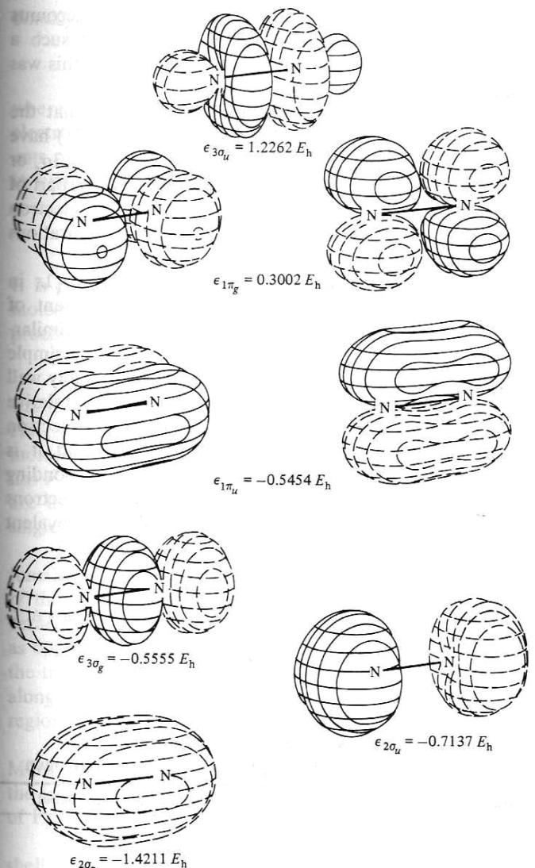
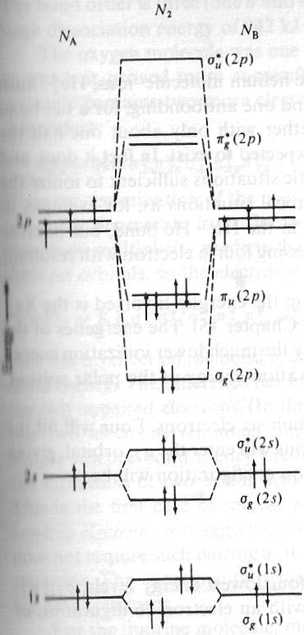
MO Energies of Dinitrogen (N₂)
Experiments tell us this picture is incorrect!

Slide 23
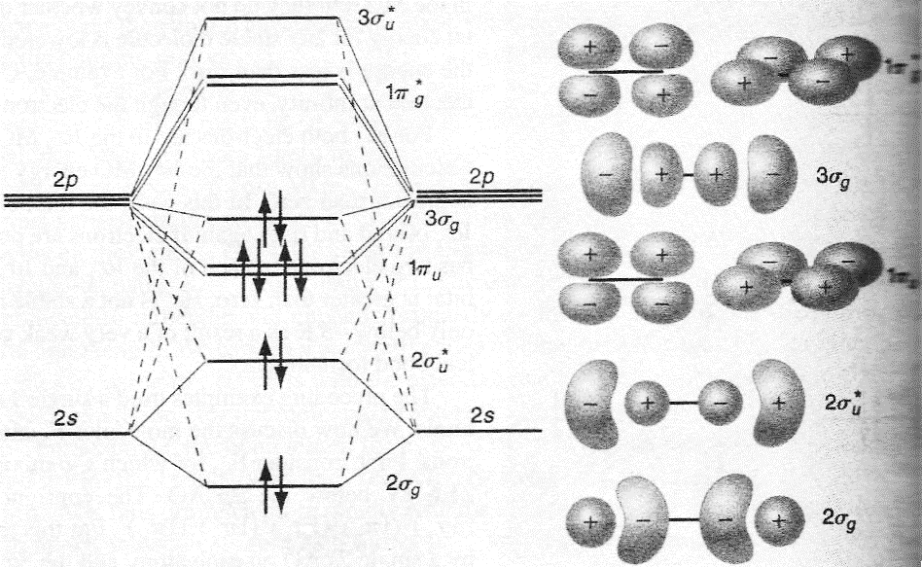
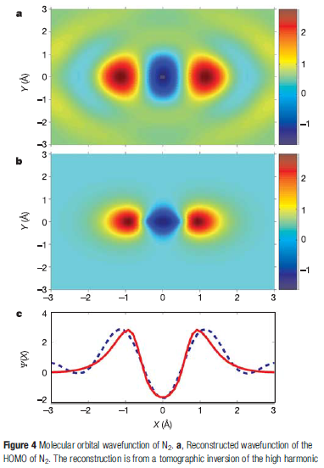
Actual MO and Energy Diagram for N₂
Nature 2004 vol 432,867
Mixing of 2S and 2P_{z} orbital → due to small energy gap
2s and 2p_{z} electrons feels not so different Z_{eff}

Slide 24
Bonding in 2nd Row Homo-Diatomic Molecules
2p
2p
2s
2s
1s
1s
The 2s and 2p orbitals are degenerate in Hydrogen. However in the many electron atoms these two sets of orbitals are no longer degenerate.

Slide 25
Bonding in 2nd Row Homo-Diatomic Molecules
2p
2p
2s
2s
1s
1s
The difference in the energies of the 2s and 2p orbitals increases along the period. Its is minimum for Li and maximum for Ne

Slide 26
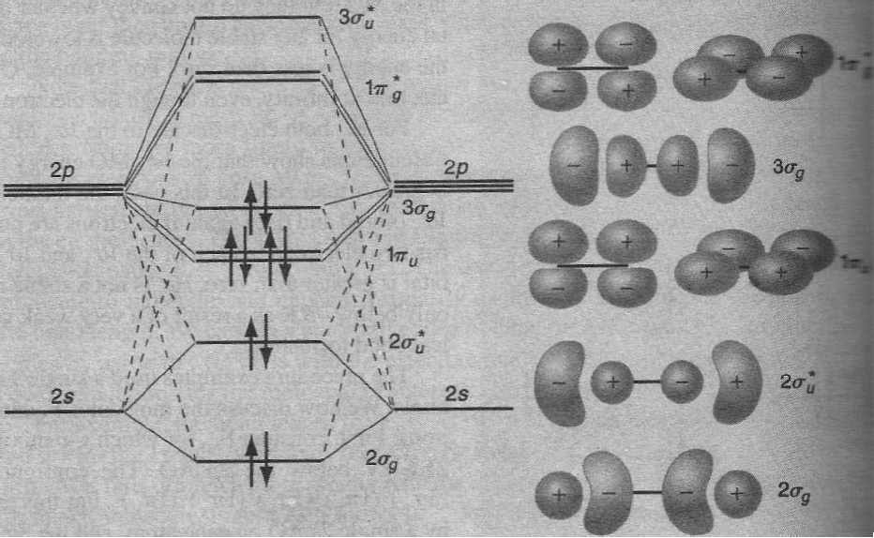
MO Energies of Dinitrogen
Mixing of 2s and 2p orbital occur because of small energy gap between them
2s and 2p electrons feels not so different nuclear charge.
Note how the MO of 2s→σ have p-type looks, while π-levels are clean

Slide 27
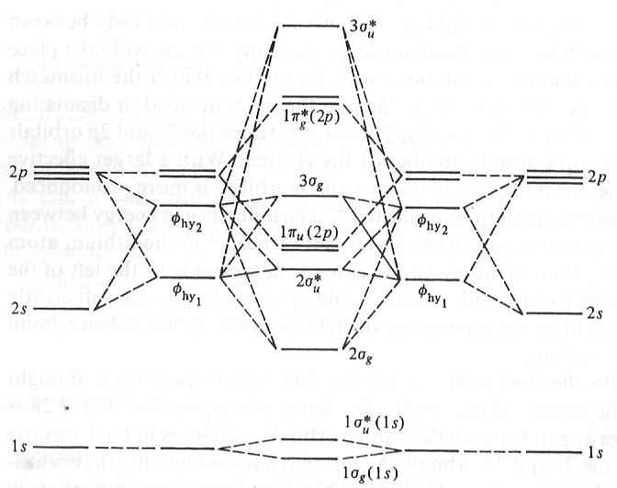
S-P Mixing in Atomic Orbitals
C1 and C2 not equal –
In the mix orbital:
S and P_{Z} →different
contributions
2S and 2P AOs MIX due to less energy gap → 2s and 2p e feels
not so different Z_{eff}. → Mixed states can form MOs

Slide 28
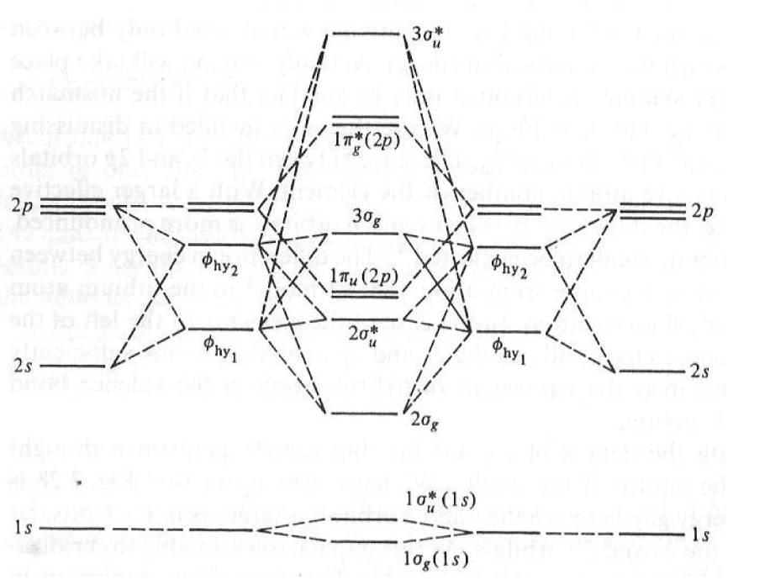
s-p Mixing: Hybridization of MO
Mixing of 2s and 2p orbital occur because of small energy gap between them 2s and 2p electrons feels not so different nuclear charge

Slide 29
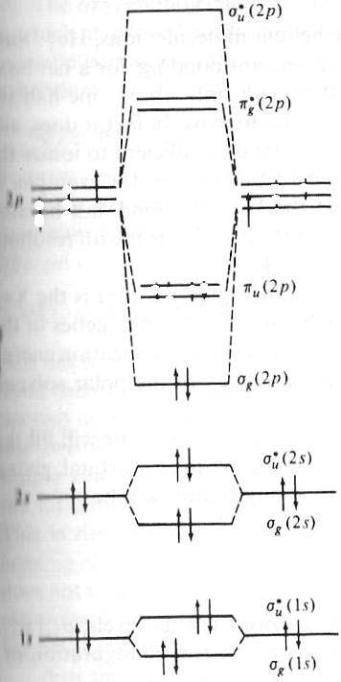
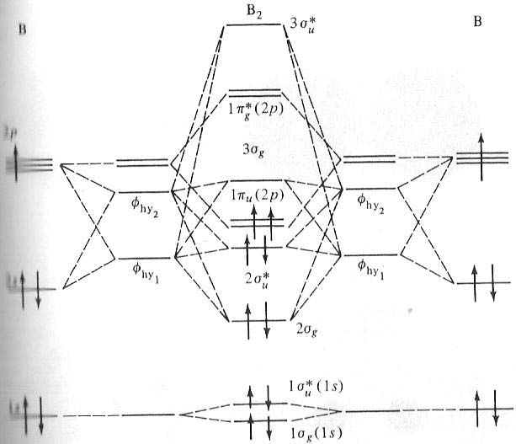
s-p Mixing: Hybridization of MO
Incorrect!
B₂ is paramagnetic. This can only happen if the two electrons with parallel spin are placed in the degenerate π-orbitals and if π orbitals are energetically lower than the σ orbital

Slide 30
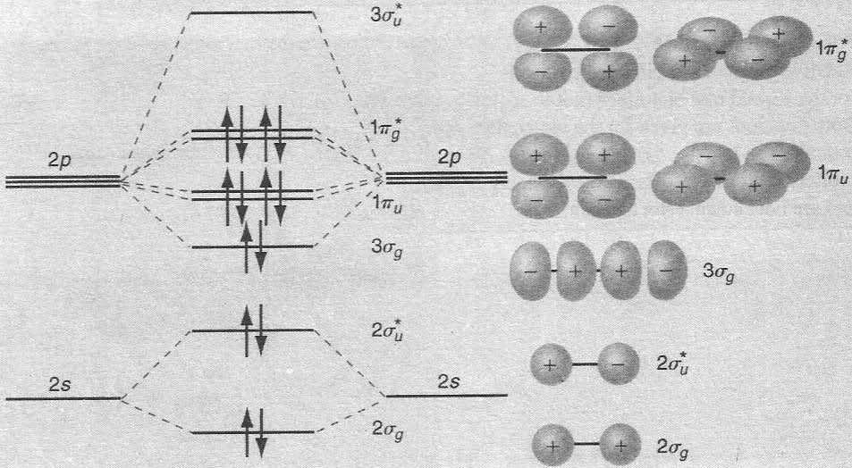
MO diagram of F₂: No s-p Mixing
No Mixing of s and p orbital because of higher energy
Gap between 2s and 2p levels in Oxygen and Fluorine!
2s and 2p electrons feels very different nuclear charge

Slide 31
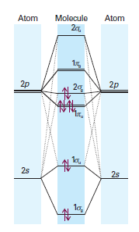
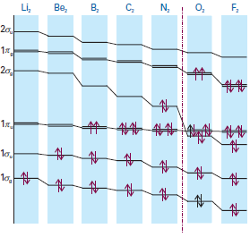
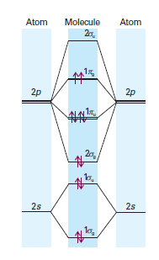
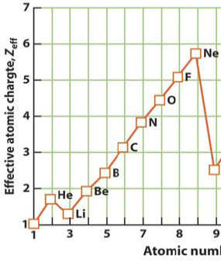
MO Energy Diagram (Homo-Diatomics)
Upto N₂
Beyond N₂
Bond Order = 0.5 x (bonding electrons - antibonding electrons)
Bond order = 0 → molecular can not exist – No bond formation
Bond order higher → stronger bond, shorter bond length

